Slide 1
Deep Object Detection Methods: Benchmarking and Sensitivity Analysis
By: Daniel Griffin, Yudhister Satija

Slide 2
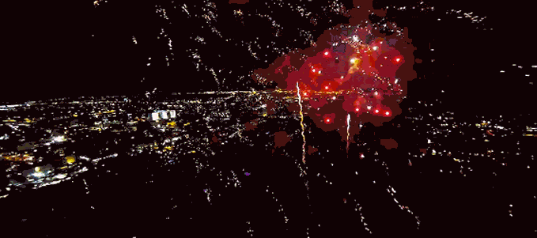
Deepnets

Slide 3
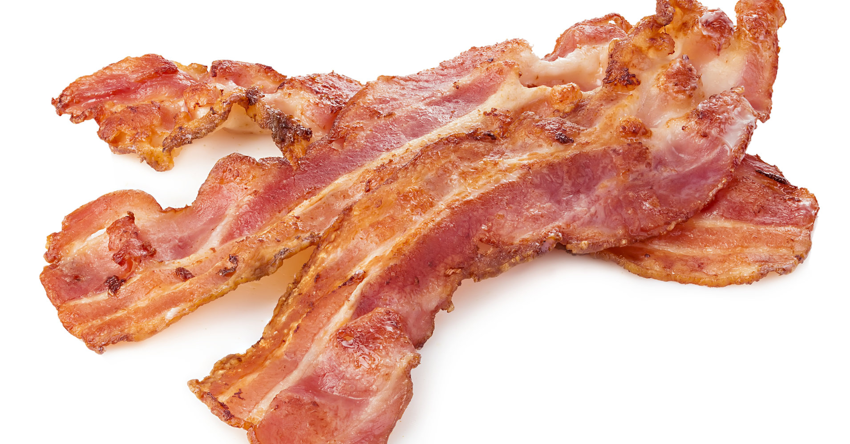

Deepnets are the new Bacon.
However, no one is really asking the question, How good is this Bacon?

Slide 4
1) Briefly explain what problem you are trying to solve [2 minutes]
2) Why is this problem important? [1 minute]
3) What is the current state-of-the-art? [1 minute]
4) What is your approach? Explain at an intuitive level, with just enough technical details needed to explain to a lay person. [2-3 minutes]
5) Show results and comparisons that demonstrate the benefit of using your approach. [2-3 minutes]
6) Discussion - what did you learn from doing this project? Where could this lead to in the future? [1 minute]

Slide 5
What problem are we trying to solve?
Are there any rules, guidelines, or insights that can be used in general for developing and using deep neural network based object detection models in “the wild”?
Sub-problems:
How easily do each of the current object detection methods break?
In what ways do current object detection methods break?
(We aren’t actively constructing images to attack a network)
Can we use this information to provide guidelines for designing and using deep nets in the real world?

Slide 6
Why is this problem important?
The current state of things:
Everyone is focused on generating more and more “new” deep object detection networks.
Practical analysis of deep object detection for use “in the wild” has fallen by the wayside.
A practical understanding or methodology for determining how Deepnets fail is crucial if we expect to use deep nets in safety concerned applications, such as autonomous driving.

Slide 7
What is the current state-of-the-art?
Networks:
Mask R-CNN, RetinaNet, Faster R-CNN , RPN , Fast R-CNN , R-FCN, YOLO
Backbones: ResNeXt{50,101,152} , ResNet{50,101,152} , Feature Pyramid Networks , and VGG16
Datasets:
COCO
PASCAL VOC
Kitti
Analysis:
Simple aggregated performance metrics
Adversarial based analysis

Slide 8
Our Approach
Benchmarking and Sensitivity Analysis:
Select most cutting edge networks.
Perform performance analysis on core images.
Generate images with “natural” errors/noise/artifacts.
Perform performance analysis on transformed images.
Compare/contrast performance to draw insights about deep network sensitivities across different network kinds.

Slide 9
The Specifics
Networks:
10 networks (Requires 11GB Graphics Cards)
Mask R-CNN, RetinaNet, Faster R-CNN , RPN , Fast R-CNN , and R-FCN .
All include region proposal for multi-object detection.
Images:
COCO image validation data set.
5000 base images (600x800 3 channel images)
50 Transforms generating 250,000 images total
5000*50*10*(300 proposals/net) = 750 Million object candidates
Systems:
8 GTX 1080ti GPU system with 11GB per Card, 8 GB Ram
i7 CPU, 24GB Ram
Condor instances

Slide 10
Image Transforms (50 total)
Value Transforms:
Blur based
Region based
Color based
Lighting based
Spatial Transforms:
Scaling based
Orientation based
Translation based
Distortion based

Slide 11
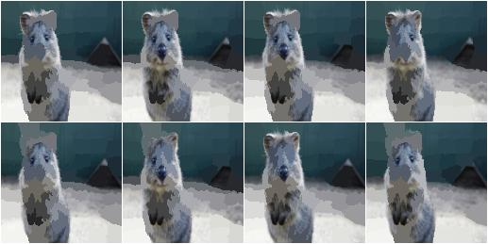
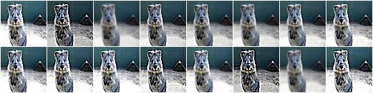
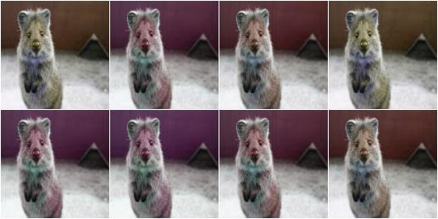
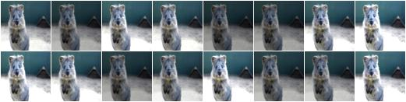
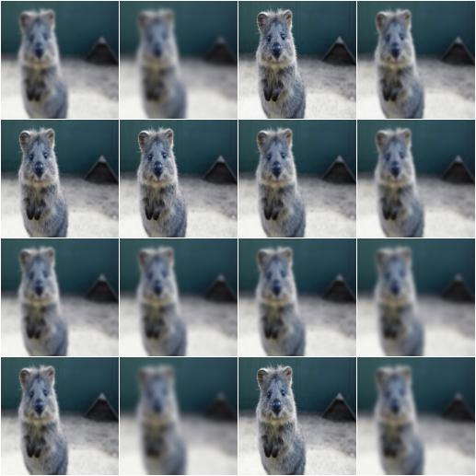
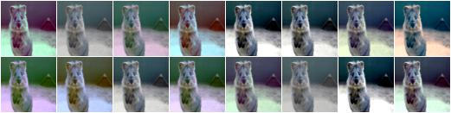
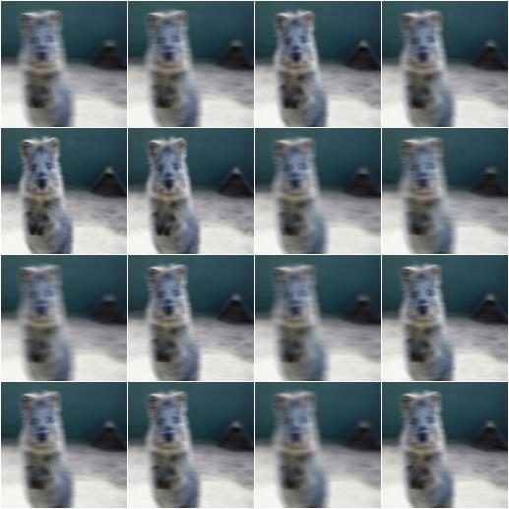
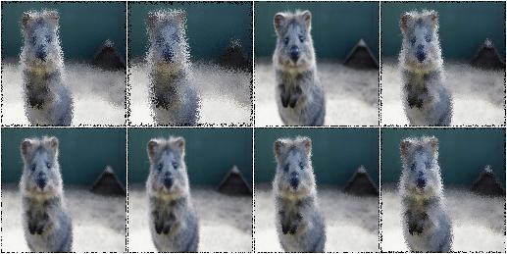
Example Value Transforms
Super Pixels
Sharpen
Colorspace Hue
Intensity Multiply
Gaussian Blur
Contrast Normalize
Average Blur
Locality Shuffling

Slide 12
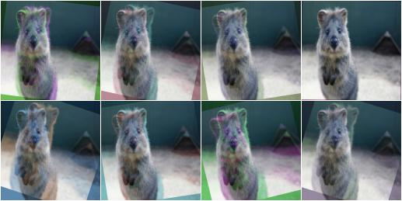
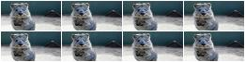
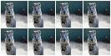
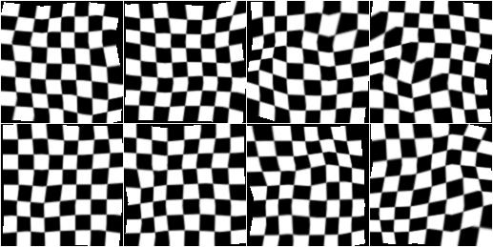
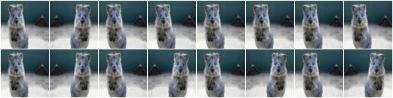
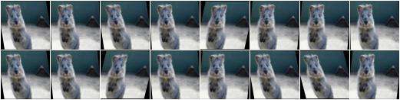
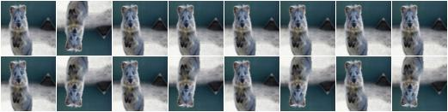
Example Spatial Transforms
Blend/Overlay
Scale
Flip L/R
Piecewise Affine
Flip U/D
Affine Scale

Slide 13
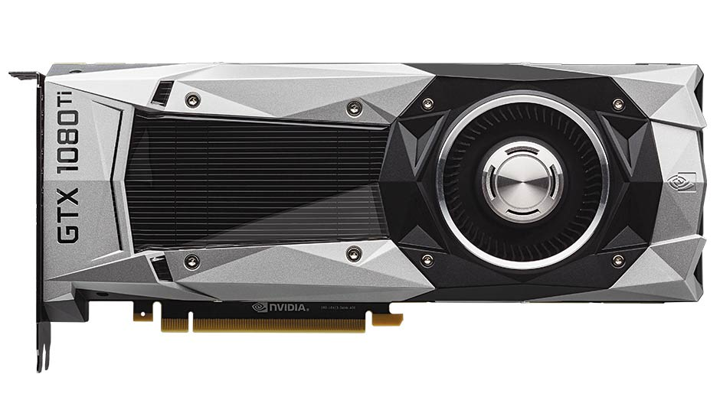
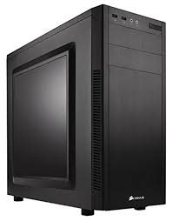

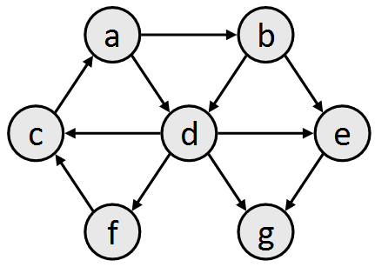
Our Pipeline
Image Transformation
Object Detection
Analysis and Visualization
Understanding
GPU System
CPU System
CPU System
CPU System
Condor System

Slide 14
Results

Slide 15
Results

Slide 16
Results

Slide 17

The Short Summary

Slide 18
The Long Summary
What did we learn from doing this project?
Most networks are brittle and need more work to make them robust.
Where could this lead to in the future?
Amount of re-training needed to reduce errors
Architectural changes/constraints needed to reduce errors
(As opposed to training on more images with different kinds of errors)
How much reducing network size for memory/speed affects errors

Slide 19
The amount of inference
1,600 images * 50 transforms = 80,000 images
80,000 images * 300 Region proposals/image = 24,000,000 candidate objects
24,000,000 candidate objects * 10 networks = 240,000,000 candidate objects
600x800x3 images >> Than most images that other networks use (usually 50x50, and sometimes 224x224 for other nets)
Compare our results with results reported in the papers!!!!! How different are they???

Slide 20
Appendix-ish
Problems:
Little understanding of how “sensitive” a network is.
What settings are most/least conducive to using a deep net?
How should I test this? What kinds of metrics are there?
What are the general guidelines on deep net errors?
Little understanding of the practical limitations of a network.
Under what imaging scenarios should networks be heavily re-trained or trained from scratch?

